Slide 1
Automation of numberplate detection
PRESENTATION

Slide 2
Introduction
A project on TRAFFIC VIOLATION DETECTION
Presented by :

Slide 3
Objectives
This project focused on learning of Automated Detection using python and it has also provided GUI.
Make it easy for the traffic police department to monitor the traffic
Date and time
Detecting number palte

Slide 4
Overview
YOLOv3
Open cv/flask /react JS
Using open cv to capturing a car number plate
Flask is making API to connect SQL light 3 data table
React js is for using wabpage and gui
Stands for You Only Look One
Vehicle detection model
Gives better accuracy for object detection
Way more faster with upgraded version

Slide 5
Methodology
Vehicle Classification:
An object detection model YOLOv3 is used to classify moving vehicles.
Features of the model:
Bounding Box Predictions
Class Prediction
Predictions across scales
Feature Extractor

Slide 6
Methodology
Bounding Box Predictions :
The network predicts 4 coordinates for each bounding box. YOLOv3 predicts an objectiveness score for each bounding box using logistic regression. 1 means complete overlap of bounding box prior over the ground truth object. It will predict only 1 bonding box prior for one ground truth object and any error in this would incur for both classification as well as detection loss.

Slide 7
Methodology
Class Predictions :
YOLOv3 uses independent logistic classifiers for each class instead of a regular SoftMax layer. This is done to make the classification multi-label classification. Each box predicts the classes the bounding box may contain using multilabel classification.

Slide 8
Methodology
Prediction across scales
YOLOv3 predicts boxes at 3 different scales
Features are extracted from each scale by using feature pyramid networks
There are 3 bounding box priors per scale and thus total 9 bounding box priors

Slide 9
Methodology
Number plate detection
The vehicles are detected using YOLOv3 model. After detecting the vehicles, violation cases are checked. A traffic line is drawn over the road in the preview of the given video footage by the user. The line specifies that the traffic light is red. Violation happens if any vehicle crosses the traffic line in red state.

Slide 10
Methodology
Number plate Detection
The detected objects have a green bounding box. If any vehicle passes the traffic light in red state, violation happens. After detecting violation, the bounding box around the vehicle becomes red.

Slide 11
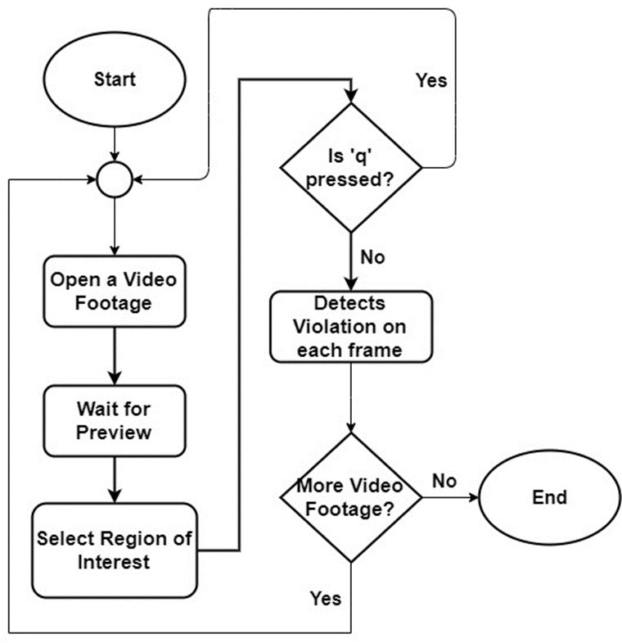
Software Overview

Slide 12
Implementation
Computer Vision
OpenCV is an open source computer vision and machine learning software library which is used in this project for image processing purpose.
Flask is for API creation
React JS is for using GUI

Slide 13
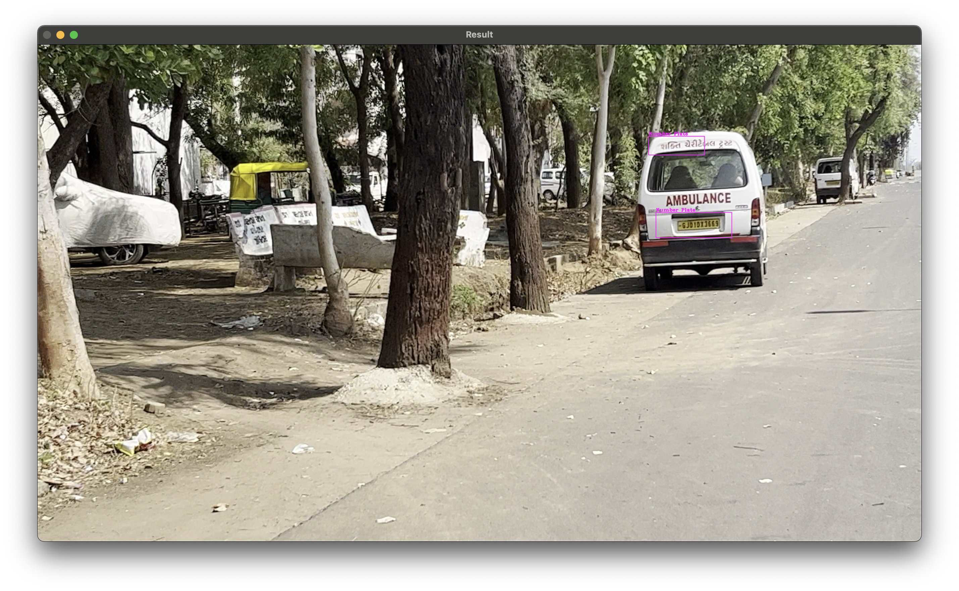
Implementation

Slide 14
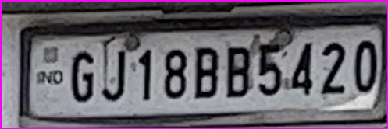
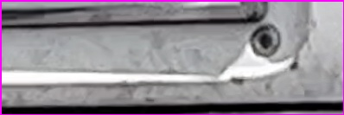
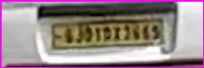
Implementation

Slide 15
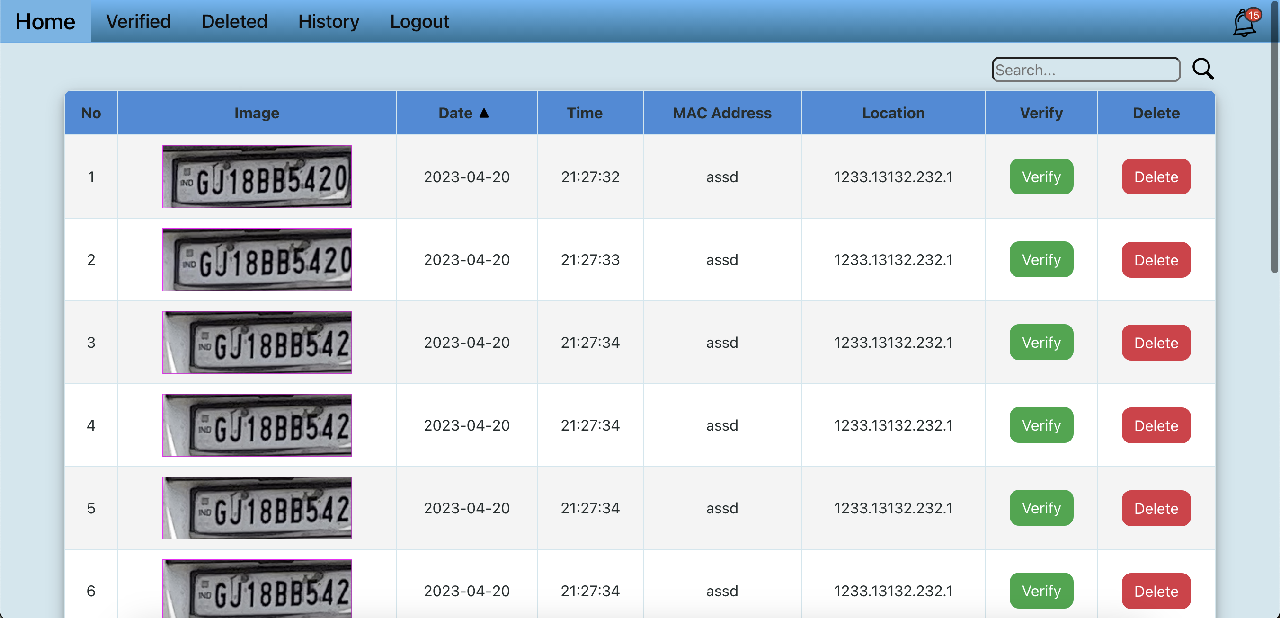
Implementation GUI wab page

Slide 16
Future Plan
Adding more real life features
Making this system more robust
Adding Number Plate Detection with OCR support
Adding more traffic violation conditions

Slide 17
Thank you

